Slide 1
SteelJackets
Team Members: Whitman Blass, Federico Ceccagnoli, Eli Katz, Luca Kurtz,
Aveed Matinfar, Christian Mattei, Grace McDonough, Evan Zappa
Liaison: Christian Mattei, cmattei22@gatech.edu
Advisor: Dr. Gamze Tokol-Goldsman
Notes:
- Add NDA statement here

Slide 2









Team Introduction
Introduction
Problem & Overview
Solution
Validation
Limitations
Implementation
Summary
Georgia Tech College of Engineering
H. Milton Stewart School of Industrial and Systems Engineering
Whit Blass
Federico Ceccagnoli
Eli Katz
Luca Kurtz
Aveed Matinfar
Christian Mattei
Grace McDonough
Evan Zappa
Notes:
10 seconds

Slide 3





Senior Design
Introduction
Problem & Overview
Solution
Validation
Limitations
Implementation
Summary
Seek opportunities for improvement in a setting appropriate for Industrial Engineering professional practice
Learn…
How Industrial Engineering methods and tools can impact the bigger organizational picture
To identify and analyze relevant factors
How to properly define and scope a problem
To apply methodologies studied in the curriculum in a cumulative and comprehensive manner
Notes:
10 seconds

Slide 4




System Overview
Introduction
Problem & Overview
Solution
Validation
Limitations
Implementation
Summary
Suppliers
Material Groups
Late Days / Month
5
4
6
2
7
10
11
Notes:
Delayed input materials lead to increased costs in three distinct ways:
One material arriving late for a product causes other materials to incur inventory costs
Delayed inputs lead to delayed orders, in turn decreasing customer satisfaction
A precautionary buildup of safety stock further increases inventory costs

Slide 5






Steelcase – By the Numbers
Introduction
Problem & Overview
Solution
Validation
Limitations
Implementation
Summary
2018 2022
2,652 Materials
25,433 Orders
48 Material Groups
93M Components
134 Suppliers
Notes:
*** Make cleaner and less wordy
Bold keywords
Process flow map??
More visual mappy/ less text

Slide 6




Declining Supplier Performance
Introduction
Problem & Overview
Solution
Validation
Limitations
Implementation
Summary
Unpredictable Delivery Time
Increased costs:
Inventory costs
Delayed production
Fees associated with late delivery to customers
Average Order Delay
2 days early → 1 day late
Percentage of On-Time Orders
95% → 88%
Notes:
*** Make cleaner and less wordy
Bold keywords
Process flow map??
More visual mappy/ less text

Slide 7
Opportunities
Introduction
Problem & Overview
Solution
Validation
Limitations
Implementation
Summary
Material Group
Suppliers | Percentage of Deliveries | Late Days / Month
 | 30% | 10
 | 40% | 6
 | 30% | 3
Select the best suppliers for a material group
Allocate more deliveries to better performing suppliers
 | 20% | 6
 | 80% | 3
Notes:
*** Make cleaner and less wordy
Bold keywords
Process flow map??
More visual mappy/ less text

Slide 8
Recommending Suppliers
Introduction
Problem & Overview
Solution
Validation
Limitations
Implementation
Summary
Material Group: Urethane Products
Supplier | Late Percentage | Number of Orders
Rogers Foam Corp. | 0% | 2
Purforms Inc. | 3% | 180
Steelcase France | 18% | 32
Intex Technologies | 23% | 211
Kent Manufacturing | 29% | 1,250
Grand Rapids Foam | 39% | 246
All Metal Designs Inc. | 40% | 5
Grand Rapids Foam (TX) | 50% | 2
Average | 33% | 241
On average, suppliers deliver 33% of orders late
1,000s of orders
8 Suppliers
Supplier performance varies

Slide 9
Recommending Suppliers
Introduction
Problem & Overview
Solution
Validation
Limitations
Implementation
Summary
Material Group: Urethane Products
Possible Strategy:
Can recommend only the best supplier
Supplier | Late Percentage | Number of Orders
Rogers Foam Corp. | 0% | 2
Purforms Inc. | 3% | 180
Steelcase France | 18% | 32
Intex Technologies | 23% | 211
Kent Manufacturing | 29% | 1,250
Grand Rapids Foam | 39% | 246
All Metal Designs Inc. | 40% | 5
Grand Rapids Foam (TX) | 50% | 2
Average | 33% | 241

Slide 10
Recommending Suppliers
Introduction
Problem & Overview
Solution
Validation
Limitations
Implementation
Summary
Material Group: Urethane Products
Possible Strategy:
Can recommend the best supplier with a reasonable amount of data
Supplier | Late Percentage | Number of Orders
Rogers Foam Corp. | 0% | 2
Purforms Inc. | 3% | 180
Steelcase France | 18% | 32
Intex Technologies | 23% | 211
Kent Manufacturing | 29% | 1,250
Grand Rapids Foam | 39% | 246
All Metal Designs Inc. | 40% | 5
Grand Rapids Foam (TX) | 50% | 2
Average | 33% | 241

Slide 11
Recommending Suppliers
Introduction
Problem & Overview
Solution
Validation
Limitations
Implementation
Summary
Material Group: Urethane Products
Supplier | Number of Orders | Weight
Rogers Foam Corp. | 2 | 00.1%
Purforms Inc. | 180 | 09.3%
Steelcase France | 32 | 16.6%
Intex Technologies | 211 | 10.9%
Kent Manufacturing | 1,250 | 64.8%
Grand Rapids Foam | 246 | 12.6%
All Metal Designs Inc. | 5 | 00.3%
Grand Rapids Foam (TX) | 2 | 00.1%
Total | 1,928 | 100%
Recommended Weight
00.0%
75.0%
20.0%
05.0%
00.0%
00.0%
00.0%
00.0%
100%

Slide 12
Recommending Suppliers
Introduction
Problem & Overview
Solution
Validation
Limitations
Implementation
Summary
Why recommend suppliers and weights?
Less Performance Risk
Can achieve near optimal performance with much less variance
Less Strategic Risk
Less risk associated without reliance on just one supplier:
Supplier might raise prices
Supplier might go bankrupt
Blending suppliers is good!

Slide 13
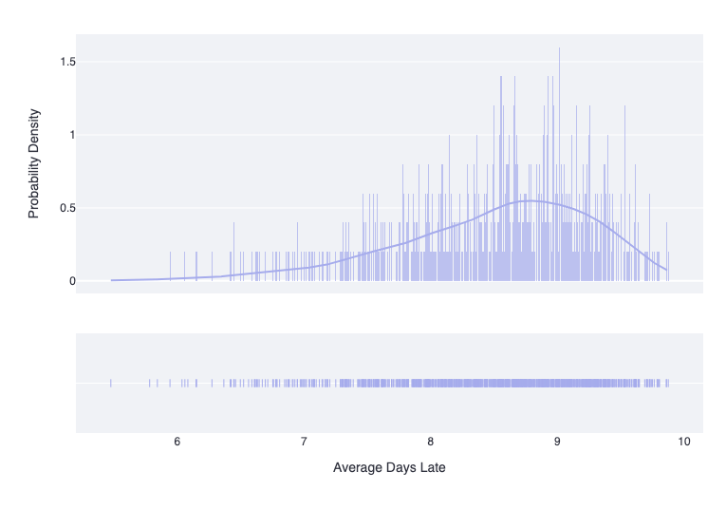
Distribution Fitting
Introduction
Problem & Overview
Solution
Validation
Limitations
Implementation
Summary
Why use probability distributions?
Possible Distribution of Average Days Late
Determine spread of possible outcomes
Understand likelihood of worst-case-scenario
Plan with confidence based on expectation
Note: Above distribution is for arbitrary weights for material group 057. The visual is for illustrative purposes only.

Slide 14
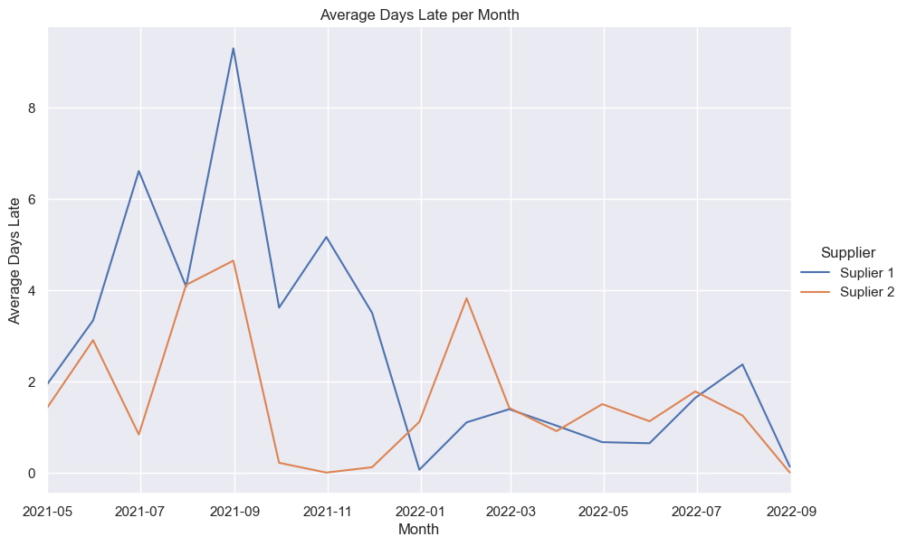
Supplier Performance
Introduction
Problem & Overview
Solution
Validation
Limitations
Implementation
Summary
How can you compare suppliers?
Average Days Late
Average is taken over all orders delivered in that month
Aggregated at the material group level

Slide 15
Joint Distributions
Introduction
Problem & Overview
Solution
Validation
Limitations
Implementation
Summary
Material Group: Urethane Products
Average Days Late by Month
Binned Data by Month
Month | Supplier 1 | Supplier 2 | Supplier 3
Nov. 21 | 6.22 | 0.00 | 3.50
Dec. 21 | 7.78 | 1.11 | 0.06
Jan. 22 | 9.33 | 3.82 | 1.10
Feb. 22 | 10.89 | 1.42 | 1.39
… | … | ... | …
Month | Supplier 1 | Supplier 2 | Supplier 3
Nov. 21 | 2 | 0 | 1
Dec. 21 | 2 | 1 | 1
Jan. 22 | 2 | 1 | 1
Feb. 22 | 2 | 1 | 1
… | … | ... | …

Slide 16
Joint Distributions
Introduction
Problem & Overview
Solution
Validation
Limitations
Implementation
Summary
Material Group: Urethane Products
Binned Data by Month
Frequency of Combinations
Month | Supp. 1 | Supp. 2 | Supp. 3
Nov. 21 | 2 | 0 | 1
Dec. 21 | 2 | 1 | 1
Jan. 22 | 2 | 1 | 1
Feb. 22 | 2 | 1 | 1
… | … | ... | …
Comb. | Supp. 1 | Supp. 2 | Supp. 3 | Frequency | Prob.
1 | 0 | 0 | 0 | 0 | 0.00
2 | 0 | 0 | 1 | 3 | 0.03
3 | 0 | 0 | 2 | 1 | 0.01
4 | 0 | 1 | 0 | 2 | 0.02
… | … | ... | … | … | …

Slide 17
Joint Distributions
Introduction
Problem & Overview
Solution
Validation
Limitations
Implementation
Summary
Material Group: Urethane Products
Binned Data by Month
Frequency of Combinations
Month | Supp. 1 | Supp. 2 | Supp. 3
Nov. 21 | 2 | 0 | 1
Dec. 21 | 2 | 1 | 1
Jan. 22 | 2 | 1 | 1
Feb. 22 | 2 | 1 | 1
… | … | ... | …
Comb. | Supp. 1 | Supp. 2 | Supp. 3 | Frequency | Prob.
1 | 0 | 0 | 0 | 0 | 0.00
2 | 0 | 0 | 1 | 3 | 0.03
3 | 0 | 0 | 2 | 1 | 0.01
4 | 0 | 1 | 0 | 2 | 0.02
… | … | ... | … | … | …

Slide 18
Joint Distributions
Introduction
Problem & Overview
Solution
Validation
Limitations
Implementation
Summary
Material Group: Urethane Products
Binned Data by Month
Frequency of Combinations
Month | Supp. 1 | Supp. 2 | Supp. 3
Nov. 21 | 2 | 0 | 1
Dec. 21 | 2 | 1 | 1
Jan. 22 | 2 | 1 | 1
Feb. 22 | 2 | 1 | 1
… | … | ... | …
Comb. | Supp. 1 | Supp. 2 | Supp. 3 | Frequency | Prob.
1 | 0 | 0 | 0 | 0 | 0.00
2 | 0 | 0 | 1 | 3 | 0.03
3 | 0 | 0 | 2 | 1 | 0.01
4 | 0 | 1 | 0 | 2 | 0.02
… | … | ... | … | … | …

Slide 19
Joint Distributions
Introduction
Problem & Overview
Solution
Validation
Limitations
Implementation
Summary
Material Group: Urethane Products
Frequency of Combinations
Material Group Performance
Comb. | Supplier 1 | Supplier 2 | Supplier 3 | Freq. | Prob.
1 | 0 | 0 | 0 | 0 | 0.00
2 | 0 | 0 | 1 | 3 | 0.03
3 | 0 | 0 | 2 | 1 | 0.01
4 | 0 | 1 | 0 | 2 | 0.02
… | … | ... | … | … | …
𝚺 Suppliers
0 + 0 + 0 = 0
0 + 0 + 1 = 1
0 + 0 + 2 = 2
0 + 1 + 0 = 1
…

Slide 20
Joint Distributions
Introduction
Problem & Overview
Solution
Validation
Limitations
Implementation
Summary
Material Group: Urethane Products
Frequency of Combinations with Weights
Weighted Material Group Performance
Comb. | W 1 | Supp. 1 | W 2 | Supp. 2 | W 3 | Supp. 3 | Freq.
1 | 20% | 0 | 30% | 0 | 50% | 0 | 0
2 | 20% | 0 | 30% | 0 | 50% | 1 | 3
3 | 20% | 0 | 30% | 0 | 50% | 2 | 1
4 | 20% | 0 | 30% | 1 | 50% | 0 | 2
… |  | … |  | ... |  | … | …
𝚺 (Weights x Suppliers) = Z
(0.2 x 0) + (0.3 x 0) + (0.5 x 0) = 0.0
(0.2 x 0) + (0.3 x 0) + (0.5 x 1) = 0.5
(0.2 x 0) + (0.3 x 0) + (0.5 x 2) = 1.0
(0.2 x 0) + (0.3 x 1) + (0.5 x 0) = 0.3
…
Changing the weights changes the distribution of the weighted material group performance!

Slide 21
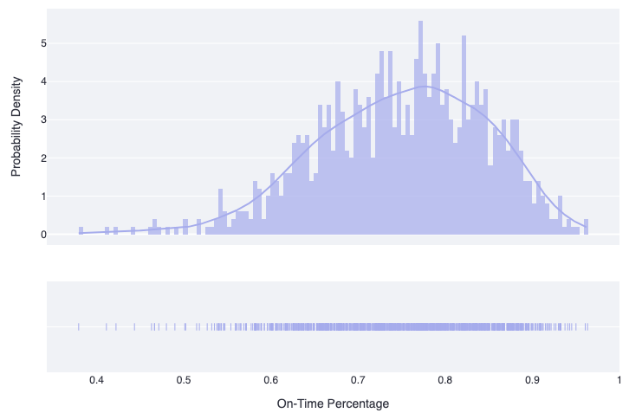
Joint Distributions
Introduction
Problem & Overview
Solution
Validation
Limitations
Implementation
Summary
Joint distribution with actual weights
Probability Distribution of On-Time %
Supplier Weights
Supplier | Weight
Purforms Inc. | 10%
Grand Rapids Foam | 60%
Intex | 10%
Steelcase France | 20%
Expected On-Time %:
73%
Standard Deviation:
24%

Slide 22
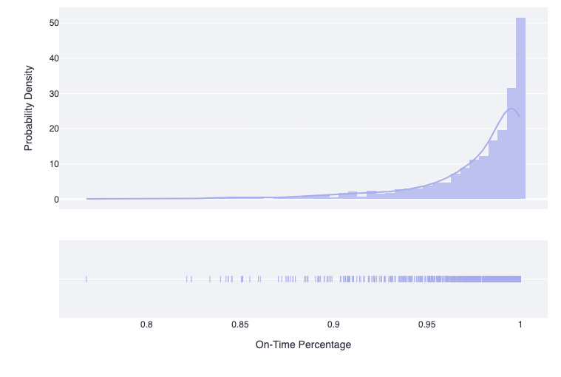
Joint Distributions
Introduction
Problem & Overview
Solution
Validation
Limitations
Implementation
Summary
Joint distribution with actual weights
Probability Distribution of On-Time %
Supplier Weights
Supplier | Weight
Purforms Inc. | 80%
Grand Rapids Foam | 10%
Intex | 00%
Steelcase France | 10%
Expected On-Time %:
73% → 96%
Standard Deviation:
23% → 4%

Slide 23

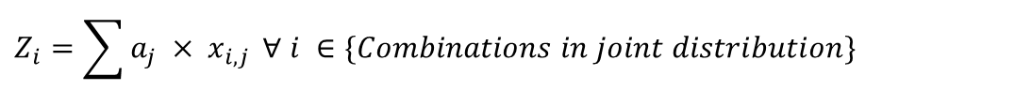

Joint Distributions
Introduction
Problem & Overview
Solution
Validation
Limitations
Implementation
Summary
Selecting the correct weights: Linear Programming
Objective Function
$$\min{ μ}(Z_{i})$$
Minimize expected average days late
Decision Variables
$$a_{j }∀ j∈\{Suppliers\}$$
Weights given to each supplier
# Decision Variables $=$# Suppliers in material group
Constraints
$$Z_{i}=\sum{{a_{j} × x}_{i,j}} ∀ i ∈\{Combinations in joint distribution\}$$
# Constraints $≈$# Possible combinations in joint distribution

Slide 24
Does it Work?
Introduction
Problem & Overview
Solution
Validation
Limitations
Implementation
Summary
Back-test the algorithm at different points in time
Average Marginal Savings:
10.9 Days per Month
Total Annual Savings:
1,046 Days
Note: The names of the material groups are listed in Appendix F
Notes:
What if we had used this methodology in the past?
T = 2021-09-01 (Giving us a full year of data after)
The actual Supplier Mix at this time was
X
Recommended supplier Mix at this time was
X
If we had followed this recommendation what would have happened?

Slide 25




Limitations
Introduction
Problem & Overview
Solution
Validation
Limitations
Implementation
Summary
There are many limitations to modeling suppliers in this way
Cost Savings
Relationship between average days late and cost is unknown
Limited Data
Suppliers with less data cannot be considered
Causality
Knowledge of external factors contributing to supplier performance is unknown
Approximation
Use of binning to calculate the joint PMF directly reduces accuracy
Notes:
What if we had used this methodology in the past?
T = 2021-09-01 (Giving us a full year of data after)
The actual Supplier Mix at this time was
X
Recommended supplier Mix at this time was
X
If we had followed this recommendation what would have happened?

Slide 26



Streamlit Introduction
Introduction
Problem & Overview
Solution
Validation
Limitations
Implementation
Summary
Streamlit is an open-source app framework made for Data Science applications.
We call Streamlit functions to display Python scripts that we create.
A user-friendly and accessible location to show all our deliverables in a visually appealing way.
What Is Streamlit?
How To Use?
Why Streamlit?

Slide 27
Streamlit Pages
Introduction
Problem & Overview
Solution
Validation
Limitations
Implementation
Summary
Streamlit Pages
Supplier Recommendations
Homepage
Analytics
Purpose: Implement the supplier selection algorithm
Notes:
Delete Homepage?

Slide 28
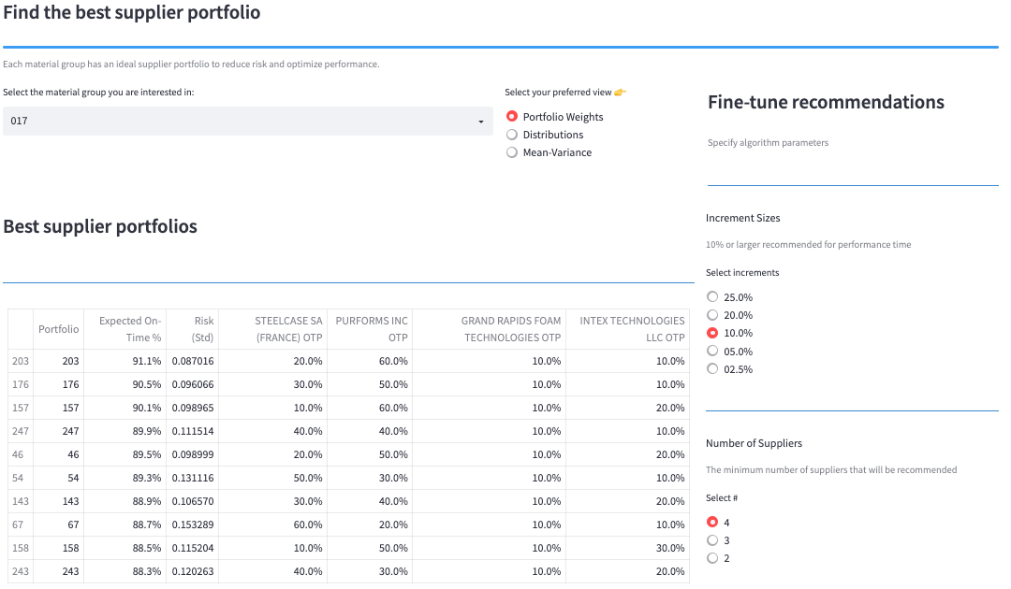
Recommendations Page – Portfolio Weights View
Introduction
Problem & Overview
Solution
Validation
Limitations
Implementation
Summary
Chosen View: Portfolio Weights
Material Group Chosen: 017
Select Increments: 10%
Number of Suppliers: 4

Slide 29
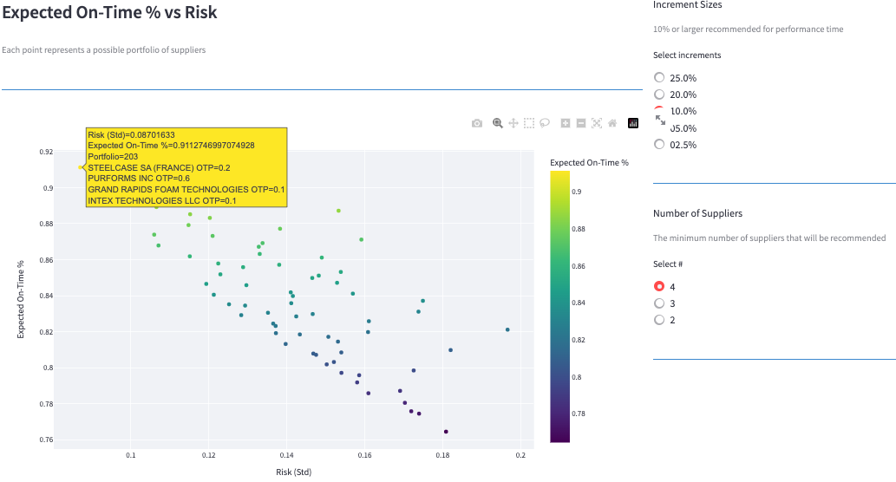
Recommendations Page – Mean-Variance View
Introduction
Problem & Overview
Solution
Validation
Limitations
Implementation
Summary
Chosen View: Mean-Variance
Material Group Chosen: 017
Select Increments: 10%
Number of Suppliers: 4

Slide 30
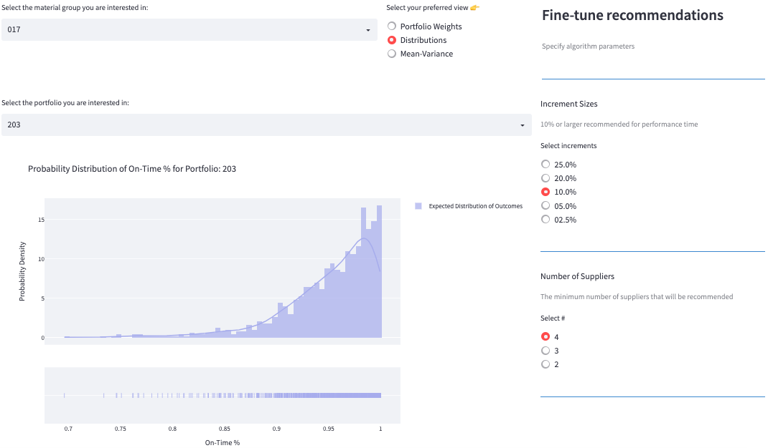
Recommendations Page – Distributions View
Introduction
Problem & Overview
Solution
Validation
Limitations
Implementation
Summary
Chosen View: Distributions
Material Group Chosen: 017
Chosen Portfolio: 203
Select Increments: 10%
Number of Suppliers: 4

Slide 31



Descriptive Analytics
Introduction
Problem & Overview
Solution
Validation
Limitations
Implementation
Summary
Opportunity: Better inform decision makers with key data that explain procurement behavior
Information
Purpose
Improve visibility in the procurement process to make it easy to immediately identify where issues are
Identify Issues:
suppliers, materials, material groups
Explain Unexpected Behavior:
compare with global supply chain index
Put supplier performance in context by overlaying data with global supply chain performance
Explore Data With Varying LOD:
Analyze performance at various levels of detail
Enable decision makers to choose how they cut and aggregate key data

Slide 32
Streamlit Pages
Introduction
Problem & Overview
Solution
Validation
Limitations
Implementation
Summary
Streamlit Pages
Supplier Recommendations
Homepage
Analytics
Purpose: Give users a high-level overview of the performance of each material group.
Notes:
Delete Homepage?

Slide 33
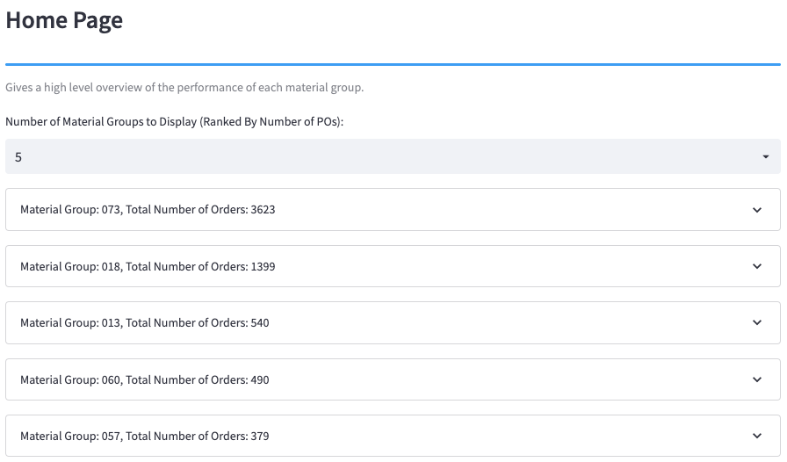
Homepage
Introduction
Problem & Overview
Solution
Validation
Limitations
Implementation
Summary
Number of Material Groups: 5
Notes:
Move To Appendix?

Slide 34
Streamlit Pages
Introduction
Problem & Overview
Solution
Validation
Limitations
Implementation
Summary
Streamlit Pages
Supplier Recommendations
Homepage
Analytics
Purpose: Explore the past and predicted performances at various levels of detail.
Notes:
Delete Homepage?

Slide 35
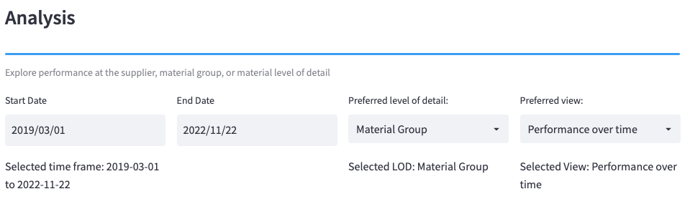
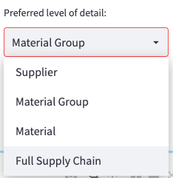
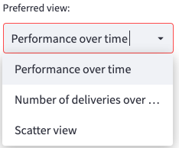
Analytics Page
Introduction
Problem & Overview
Solution
Validation
Limitations
Implementation
Summary

Slide 36
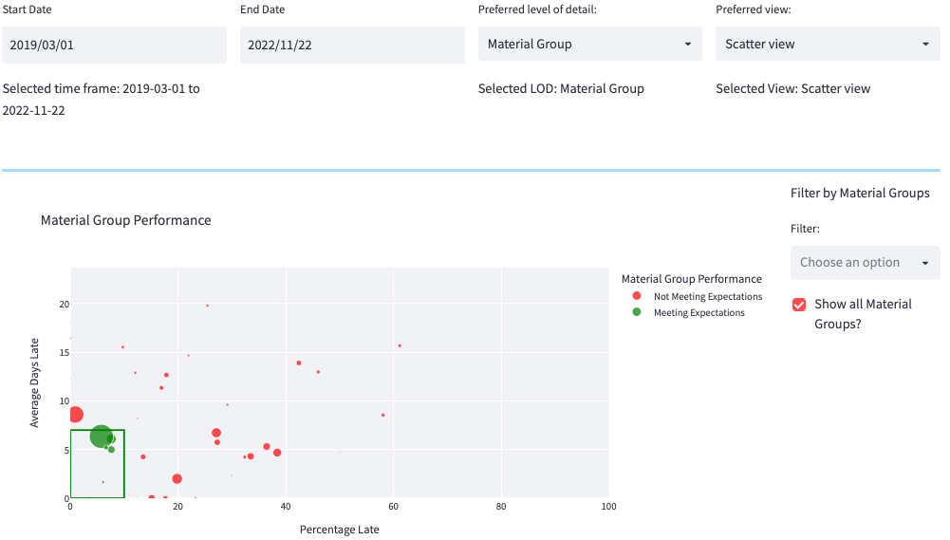
Analytics Page – Scatter
Introduction
Problem & Overview
Solution
Validation
Limitations
Implementation
Summary
Chosen View: Scatter
Level of Detail: Material Group
Show All Material Groups?: Yes
Dates: 2019/03/01 - 2022/11/22

Slide 37
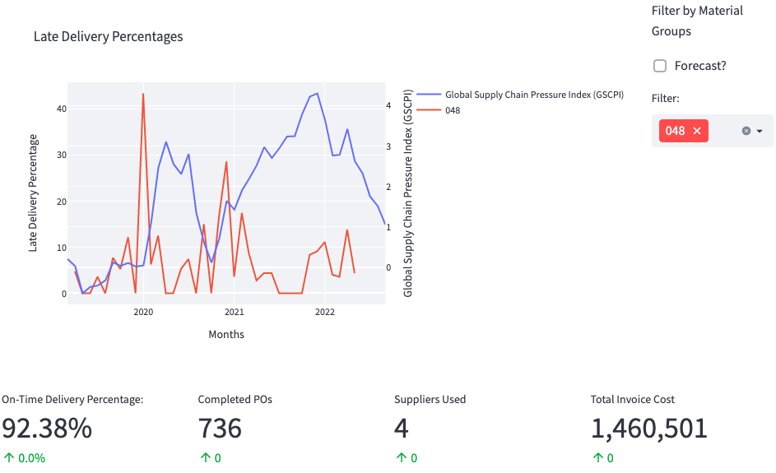
Analytics Page – Performance Over Time
Introduction
Problem & Overview
Solution
Validation
Limitations
Implementation
Summary
Chosen View: Performance Over Time
Level of Detail: Material Group
Material Group Chosen: 048
Forecast?: No
Dates: 2019/03/01 - 2022/11/22

Slide 38


Forecasting - Opportunity
Introduction
Problem & Overview
Solution
Validation
Limitations
Implementation
Summary
Visualize supply chain trends and directionality
Make supplier selection choices using forward-looking forecasts

Slide 39
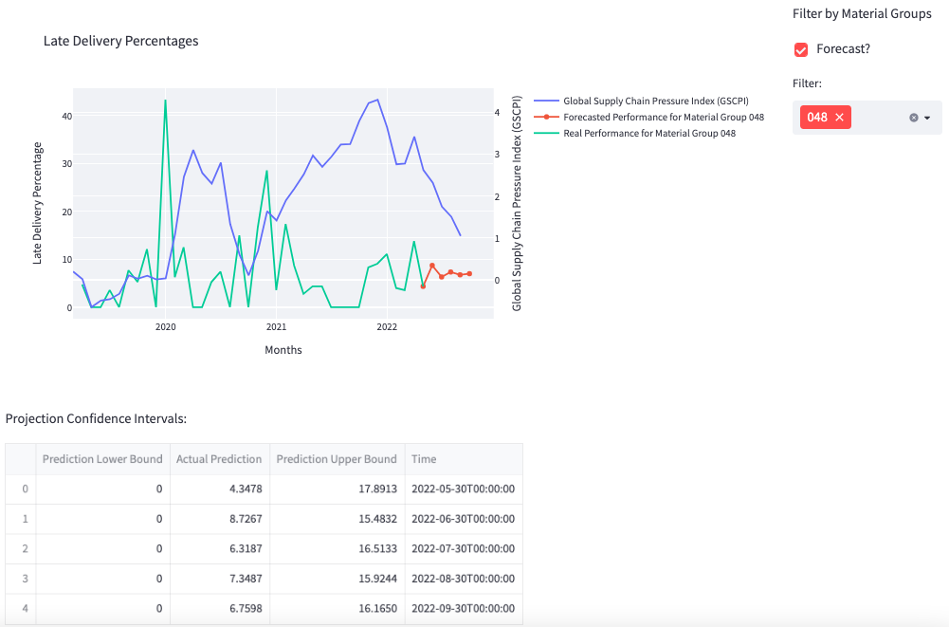
Analytics Page – Performance Over Time
Introduction
Problem & Overview
Solution
Validation
Limitations
Implementation
Summary
Chosen View: Performance Over Time
Level of Detail: Material Group
Material Group Chosen: 048
Forecast?: Yes
Dates: 2019/03/01 - 2022/11/22

Slide 40







Summary
Introduction
Problem & Overview
Solution
Validation
Limitations
Implementation
Summary
How can the client expect to gain value?
Descriptive Analytics
Greater Visibility into procurement performance
Forecasting
Prepare and compare with global supply chain
Prescriptive Analytics
Business decisions backed by data-driven insights

Slide 41
Appendix

Slide 42
Appendix A: Supplier Performance Metrics
Introduction
Problem & Overview
Deliverable #1
Deliverable #2
Implementation
Summary
How are suppliers judged?
On-Time Percentage (OTP)
Average Days Late (ADL)
Average Days Late When Late
Order | # Days Late
1 | 0
2 | 10
3 | 2
4 | 0
3 Days
6 Days
On-Time Percentage
50%
ADL When Late
Average Days Late

Slide 43
Appendix A: Supplier Performance Metrics Cont’d
Introduction
Problem & Overview
Deliverable #1
Deliverable #2
Implementation
Summary
How are suppliers judged?
On-Time Percentage (OTP)
Average Days Late (ADL)
Average Days Late When Late
A couple things to know:
Supplier performance is aggregated on monthly intervals
Supplier performance is aggregated at the material group level
Idea:
We can model supplier performance (ADL) as a probability distribution

Slide 44
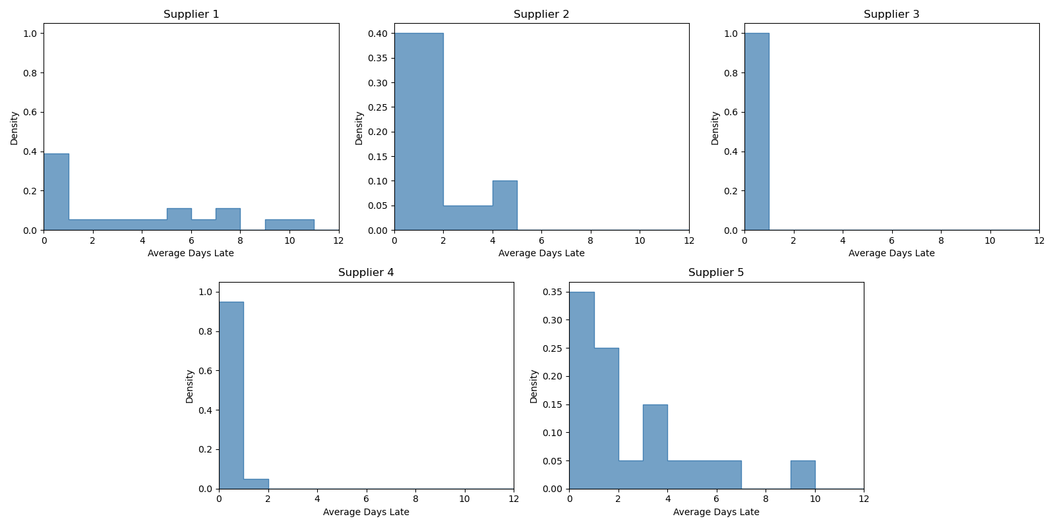
Appendix B: Supplier Performance Distributions
Introduction
Problem & Overview
Solution
Validation
Limitations
Implementation
Summary
Notes:
Maybe cut

Slide 45
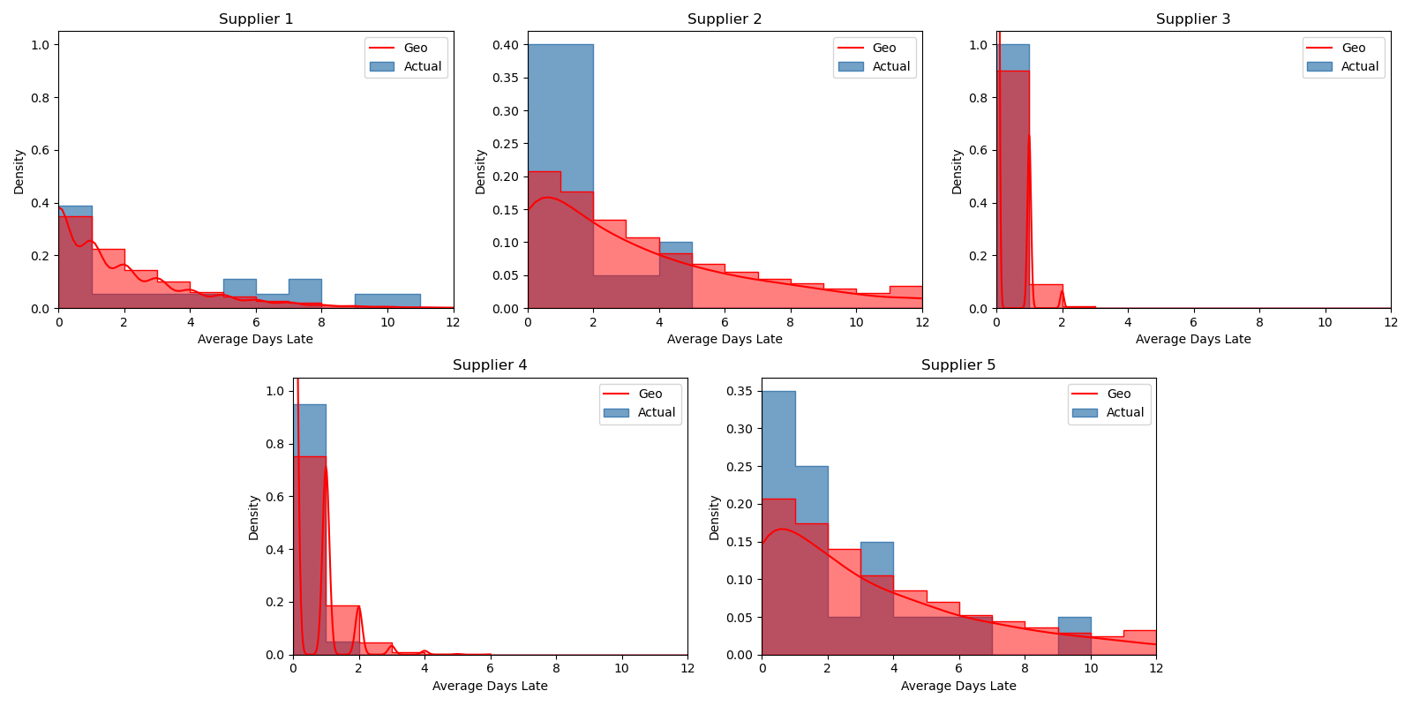
Appendix C: Supplier Performance Distributions Fit
Introduction
Problem & Overview
Solution
Validation
Limitations
Implementation
Summary
Notes:
Maybe cut

Slide 46
Appendix D: Monthly Trials
Introduction
Problem & Overview
Deliverable #1
Deliverable #2
Implementation
Summary
What if we used this methodology in the past?
Date | Average Monthly Total Days Late (Recommended) | Average Monthly Total Days Late (Actual) | Marginal Improvement
5/1/21 | 7.48 | 10.61 | 3.13
6/1/21 | 3.75 | 11.03 | 7.28
7/1/21 | 3.98 | 11.02 | 7.04
8/1/21 | 4.23 | 11.16 | 6.94
9/1/21 | 4.41 | 8.58 | 4.17
10/1/21 | 4.73 | 8.39 | 3.66
Average | 4.76 | 10.13 | 5.37
Notes:
What if we had used this methodology in the past?
T = 2021-09-01 (Giving us a full year of data after)
The actual Supplier Mix at this time was
X
Recommended supplier Mix at this time was
X
If we had followed this recommendation what would have happened?

Slide 47
Appendix E: Monthly Trials Visualized
Introduction
Problem & Overview
Solution
Validation
Limitations
Implementation
Summary
What if we change the implementation date?
Average Marginal Improvement:
5.5 Days / Month
Notes:
What if we had used this methodology in the past?
T = 2021-09-01 (Giving us a full year of data after)
The actual Supplier Mix at this time was
X
Recommended supplier Mix at this time was
X
If we had followed this recommendation what would have happened?

Slide 48
Appendix F: Trials by Month / Material Group
Introduction
Problem & Overview
Deliverable #1
Deliverable #2
Implementation
Summary
What if we used this methodology in the past?
Marginal Improvement by Material Group
Implementation Date | 073 | 013 | 017 | 032 | 012 | 014 | 060 | 018
5/1/21 | 3.13 | 28.55 | 27.13 | 0.39 | 17.01 | 5.25 | 27.64 | 0.01
6/1/21 | 7.28 | 29.48 | 15.91 | 0.42 | 17.86 | 5.58 | 27.87 | 0.00
7/1/21 | 7.04 | 30.46 | 21.07 | -0.36 | 18.26 | 4.62 | 26.38 | 0.01
8/1/21 | 6.94 | 28.08 | -10.14 | -10.02 | -10.70 | 4.98 | 25.31 | 0.00
9/1/21 | 4.17 | 23.04 | -18.12 | -11.05 | 14.05 | 6.72 | 24.53 | 0.01
10/1/21 | 3.66 | 20.40 | -24.82 | 0.81 | 22.84 | 7.33 | 26.63 | 0.01
Average Monthly Late Days Saved | 5.37 | 26.67 | 1.84 | -3.30 | 13.22 | 5.75 | 26.39 | 0.01
911
Average Total Days Saved
Average Yearly Late Days Saved | 64.44 | 320.04 | 22.08 | -39.6 | 158.64 | 69 | 316.68 | 0.08
Notes:
What if we had used this methodology in the past?
T = 2021-09-01 (Giving us a full year of data after)
The actual Supplier Mix at this time was
X
Recommended supplier Mix at this time was
X
If we had followed this recommendation what would have happened?

Slide 49
Joint Distributions
Introduction
Problem & Overview
Solution
Validation
Limitations
Implementation
Summary
Material Group: Urethane Products
Binned Data by Month
Frequency of Combinations
Month | Supplier 1 | Supplier 2 | Supplier 3
11/01/21 | 2 | 0 | 1
12/01/21 | 2 | 1 | 1
1/01/22 | 2 | 1 | 1
2/01/22 | 2 | 1 | 1
… | … | ... | …
Comb. | Supplier 1 | Supplier 2 | Supplier 3 | Frequency | Prob.
1 | 0 | 0 | 0 | 0 | 0.00
2 | 0 | 0 | 1 | 3 | 0.03
3 | 0 | 0 | 2 | 1 | 0.01
4 | 0 | 1 | 0 | 2 | 0.02
… | … | ... | … | … | …

Slide 50
Joint Distributions
Introduction
Problem & Overview
Solution
Validation
Limitations
Implementation
Summary
Material Group: Urethane Products
Binned Data by Month
Frequency of Combinations
Month | Supplier 1 | Supplier 2 | Supplier 3
11/01/21 | 2 | 0 | 1
12/01/21 | 2 | 1 | 1
1/01/22 | 2 | 1 | 1
2/01/22 | 2 | 1 | 1
… | … | ... | …
Comb. | Supplier 1 | Supplier 2 | Supplier 3 | Frequency | Prob.
1 | 0 | 0 | 0 | 0 | 0.00
2 | 0 | 0 | 1 | 3 | 0.03
3 | 0 | 0 | 2 | 1 | 0.01
4 | 0 | 1 | 0 | 2 | 0.02
… | … | ... | … | … | …

Slide 51
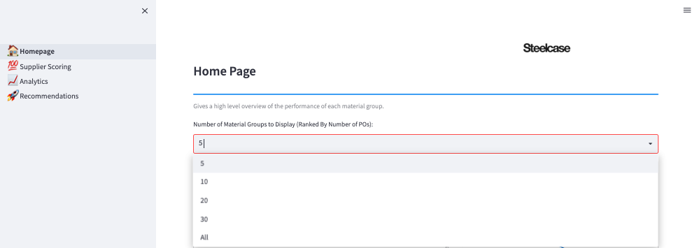
Appendix G: Homepage
Introduction
Problem & Overview
Deliverable #1
Deliverable #2
Implementation
Summary
Notes:
Move To Appendix?

Slide 52
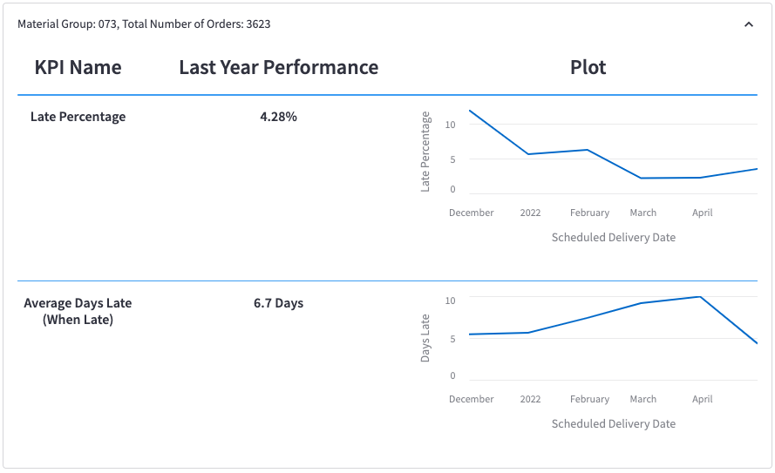
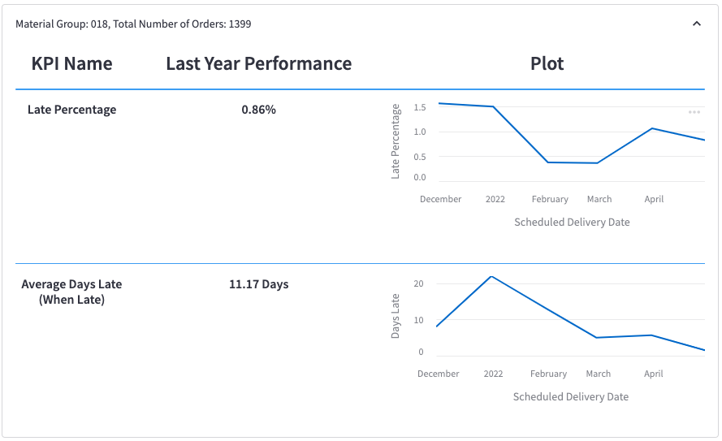
Appendix G: Homepage Cont’d
Introduction
Problem & Overview
Deliverable #1
Deliverable #2
Implementation
Summary
Expanded dropdowns for top two material groups.
Notes:
Move To Appendix?

Slide 53
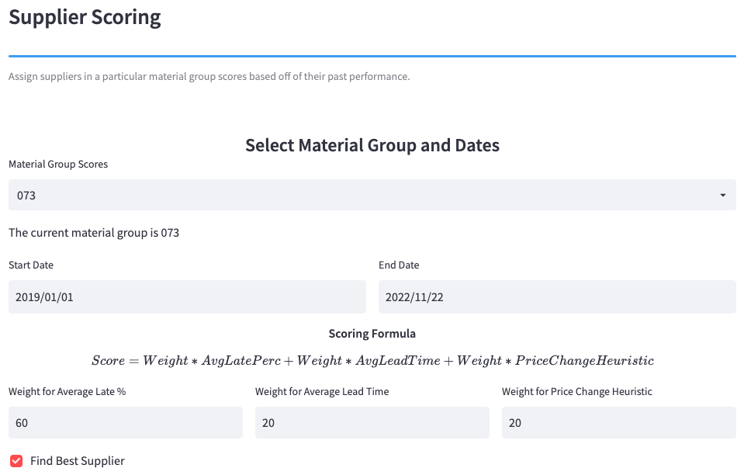
Appendix H: Supplier Scoring Page
Introduction
Problem & Overview
Deliverable #1
Deliverable #2
Implementation
Summary
Notes:
Move To Appendix

Slide 54
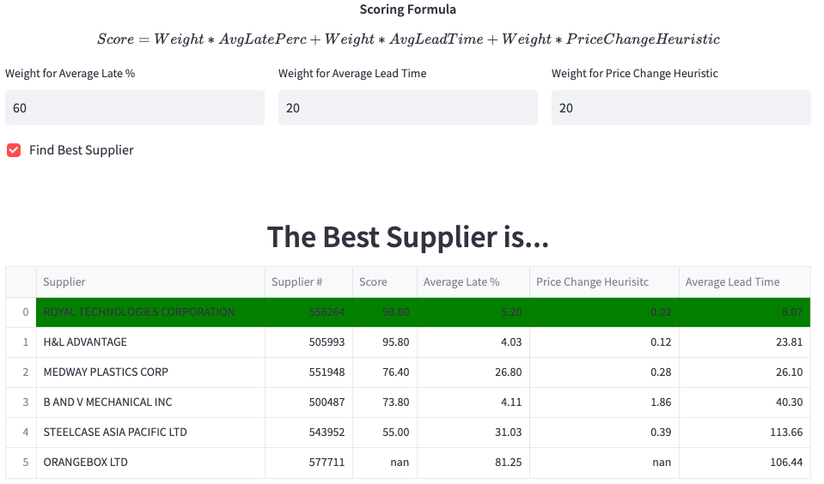
Appendix H: Supplier Scoring Page Cont’d
Introduction
Problem & Overview
Deliverable #1
Deliverable #2
Implementation
Summary
Material Group Chosen: 073
Dates: 2019/03/01 - 2022/11/22
Weights: 60% - Avg Late %
20% - Avg Lead Time
20% - Price Heuristic
Notes:
Move To Appendix

Slide 55
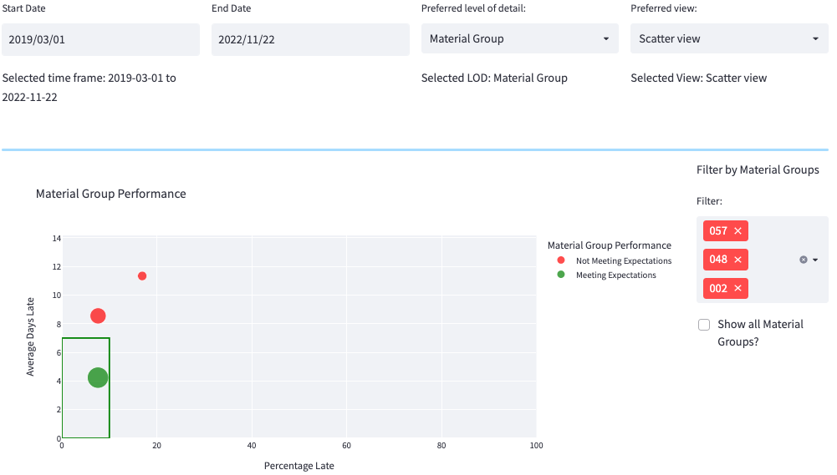
Appendix I: Analytics Page – Scatter
Introduction
Problem & Overview
Deliverable #1
Deliverable #2
Implementation
Summary
Chosen View: Scatter
Level of Detail: Material Group
Material Groups Chosen: 002, 048, 057
Show All Material Groups?: No
Dates: 2019/03/01 - 2022/11/22

Slide 56
Appendix J: Original Success Metrics
Introduction
Problem
System Overview
Project Deliverables
Success Metrics
Performance Improvement
Move on time PO percentage from 88% to 99%
Financial Impact
Drive savings through increased supplier reliability and decreased supplier costs
Supplier Reliability
Reduce delayed production cycles
Reduce safety stock requirements
Reduce inventory costs
Increase customer fulfillment
Supplier Costs
Cost of materials
Propensity to increase costs

Slide 57
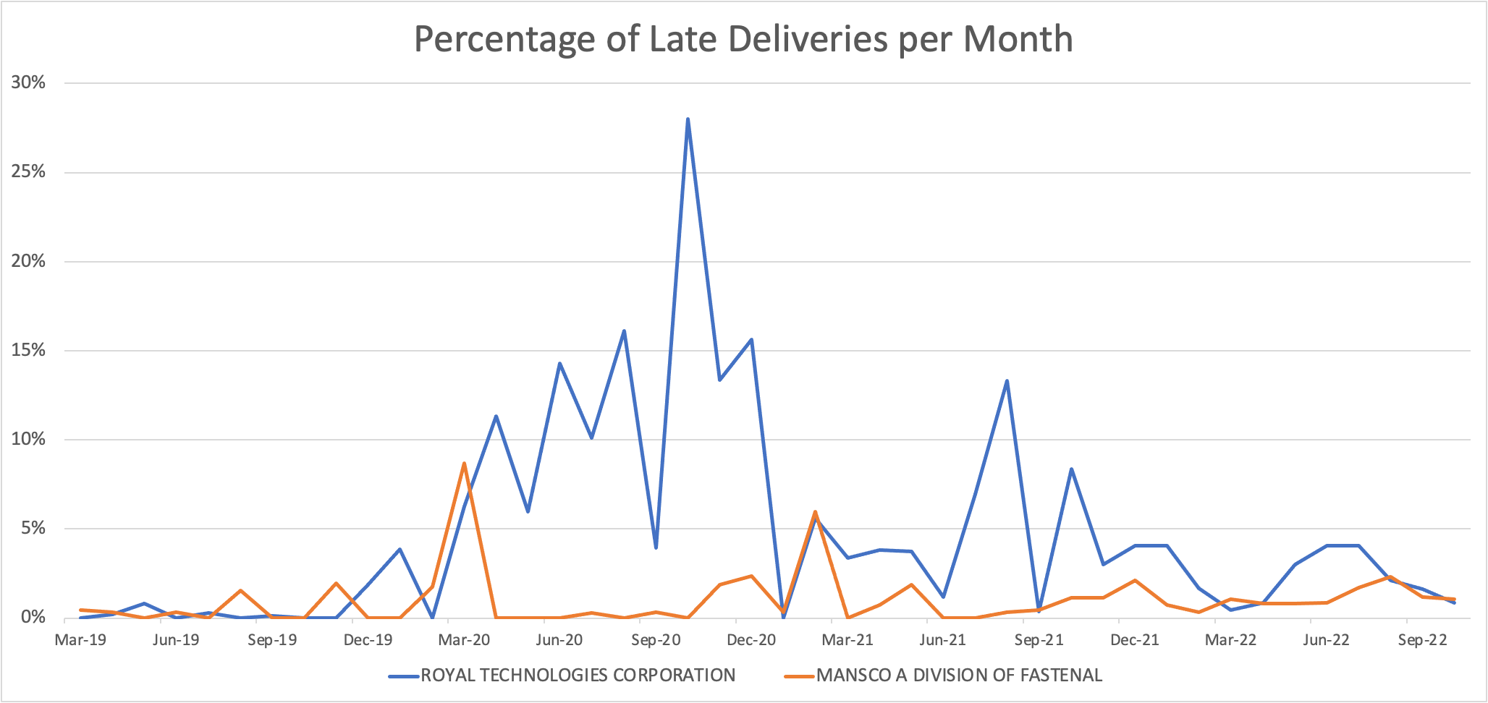
Appendix K: Forecasting - Implementation
Introduction
Problem
System Overview
Project Deliverables
Success Metrics
Forecast begins at the black line in May 2022
Notes:
Talk through – missing data for delivery in full rates to back up this claim statistically
What I want to put on this slide:
Negative things or things that could use changing:
-
Main Goal:
- An efficient supply chain that is adaptable to changes and is Steelcase's ideal balance of many objectives.

Slide 58
Appendix K: Forecasting - Implementation Cont’d
Introduction
Problem
System Overview
Project Deliverables
Success Metrics
Using Historical Data
Supplier​ | Score​ | On-Time (%) | Lateness Severity | Expected Lead Time | Cost
Royal | 98​ | 95%​ | 2 Days | 8 Days​ | 0.02
B | 76 | 73%​ | 7 Days | 26 Days​ | 0.28
Using Forecasted Data
Supplier​ | Score​ | On-Time (%) | Lateness Severity | Expected Lead Time | Cost
Royal | 99​ | 98%​ | 2 Days | 8 Days​ | 0.02
B | 73 | 70%​ | 7 Days | 26 Days​ | 0.28
Currently Forecasted
Potential for Forecasting
*Some of the data in the tables is not real data*
Notes:
Talk through – missing data for delivery in full rates to back up this claim statistically
What I want to put on this slide:
Negative things or things that could use changing:
-
Main Goal:
- An efficient supply chain that is adaptable to changes and is Steelcase's ideal balance of many objectives.

Slide 59



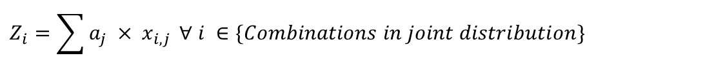
Appendix L: Joint Distributions
Introduction
Problem & Overview
Solution
Validation
Limitations
Implementation
Summary
Selecting the correct weights: Linear Programming
OBJ:
$$\min{ μ}(Z_{i})$$
$$a_{j }∀ j∈\{Suppliers\}$$
Weights given to each supplier
$$Z_{i}=\sum{{a_{j} × x}_{i,j}} ∀ i ∈\{Combinations in joint distribution\}$$
S.t. :
$$\sum{a_{j}=1}$$
$$a_{j} ≥0 ∀ j∈\{Suppliers\}$$
$$a_{j} ∈\left\{0.1, 0.2, 0.3, 0.4, 0.5, 0.6, 0.7, 0.8, 0.9\right\} ∀ j∈\left\{Suppliers\right\}$$

Slide 60
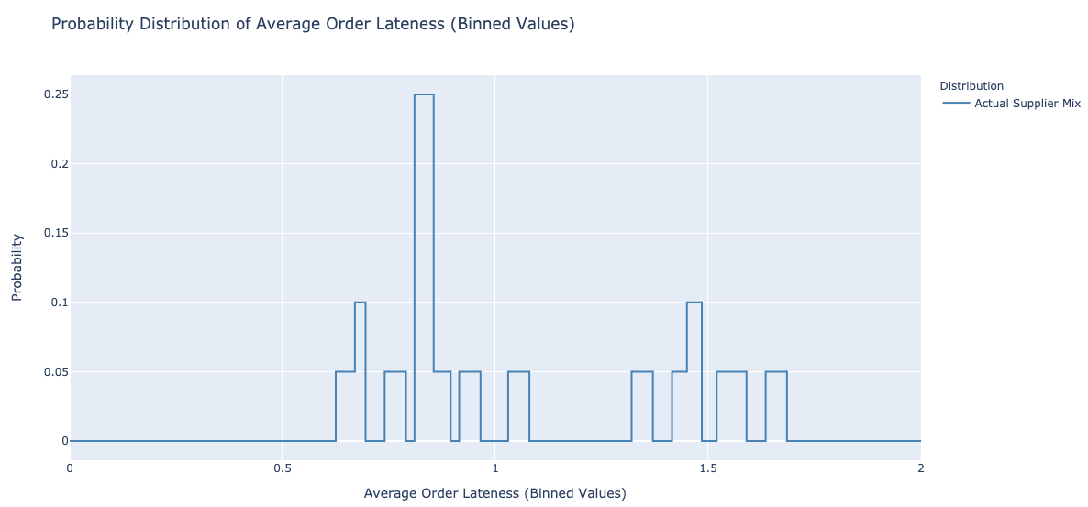
Appendix M: Joint Distributions Cont’d
Introduction
Problem & Overview
Solution
Validation
Limitations
Implementation
Summary
Joint distribution with actual weights
Material Group Performance:
Actual Weights
𝚺 (Weights x Suppliers) = Z
(0.2 x 0) + (0.3 x 0) + (0.5 x 0) = 0.0
(0.2 x 0) + (0.3 x 0) + (0.5 x 1) = 0.5
(0.2 x 0) + (0.3 x 0) + (0.5 x 2) = 1.0
(0.2 x 0) + (0.3 x 1) + (0.5 x 0) = 0.3
…
Mean:
0.96
STD:
0.63
Weight 1 | Weight 2 | Weight 3
20% | 30% | 50%

Slide 61
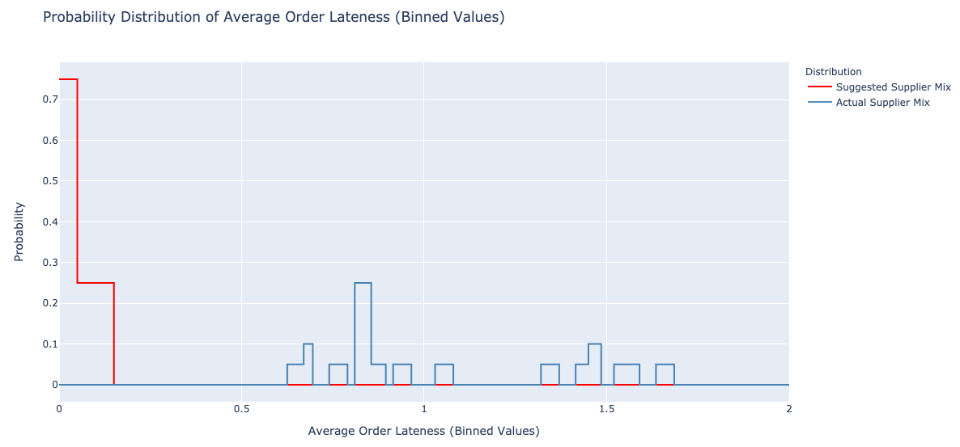
Appendix M: Joint Distributions Cont’d
Introduction
Problem & Overview
Solution
Validation
Limitations
Implementation
Summary
Joint distribution with recommended weights
Material Group Performance:
Recommended Weights
𝚺 (Weights x Suppliers) = Z
(0.0 x 0) + (0.9 x 0) + (0.1 x 0) = 0.0
(0.0 x 0) + (0.9 x 0) + (0.1 x 1) = 0.5
(0.0 x 0) + (0.9 x 0) + (0.1 x 2) = 1.0
(0.0 x 0) + (0.9 x 1) + (0.1 x 0) = 0.3
…
Mean:
0.96
0.15
STD:
0.63
0.06
Weight 1 | Weight 2 | Weight 3
00% | 90% | 10%

Slide 62
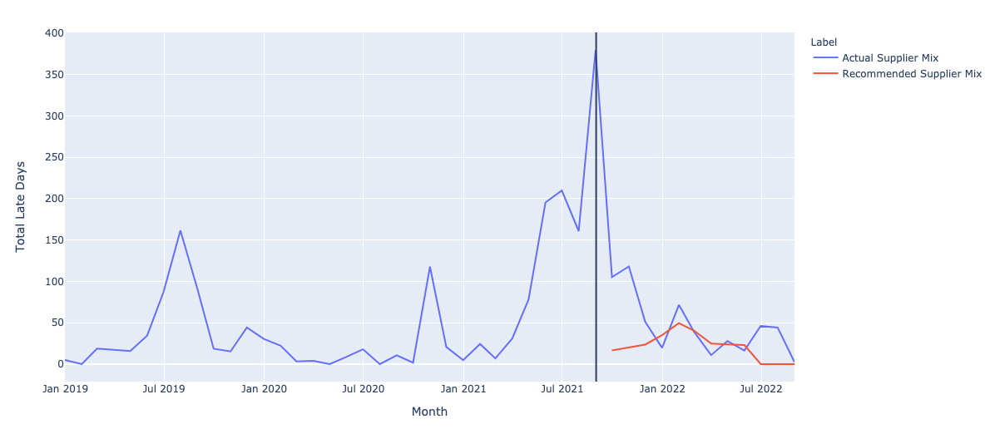
Appendix O: Does it Work?
Introduction
Problem & Overview
Solution
Validation
Limitations
Implementation
Summary
What if we used this methodology in the past?
Material Group:
Urethane Products
Date: Aug. 2021
Actual Weights
Purforms Inc. | Steelcase France
90% | 10%
Notes:
What if we had used this methodology in the past?
T = 2021-09-01 (Giving us a full year of data after)
The actual Supplier Mix at this time was
X
Recommended supplier Mix at this time was
X
If we had followed this recommendation what would have happened?

